Slide 1
Machine Learning

Slide 2
Introduction
Machine learning is an application of artificial intelligence (AI) that provides systems the ability to automatically learn and improve from experience without being explicitly programmed. Machine learning focuses on the development of computer programs that can access data and use it learn for themselves.

Slide 3
Machine Learning Algorithms
Used for
  Supervised Learning
  Unsupervised Learning

Slide 4
Basic Algorithms
Most of data related real world problems are either prediction problems
As an AI programmer your job is to choose the BEST algorithm depending upon
  The problem and its parameters
  Underlying assumptions

Slide 5
Linear Regression
Most commonly used to express linear relationship between two variables
  Outcome variable (response variable, dependent variable, label)
  Predictor (Independent variable, explanatory variable, feature)
Can also be used when there is a linear relationship between one variable and several other variables

Slide 6
Simple Linear Regression
Good starting point for many problems (first assumption)

Slide 7
Simple Linear Regression
Linear regression is a very simple method but has proven to be very useful for a large number of situations.

Slide 8
How to calculate a simple linear regression step-by-step
x | y
1 | 1
2 | 3
4 | 3
3 | 2
5 | 5

Slide 9
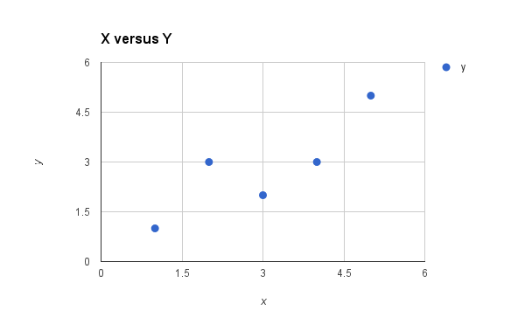
Simple scatter plot of x versus y
Plot of the Dataset for Simple Linear Regression

Slide 10
Simple linear regression
With simple linear regression we want to model our data as follows:
y = B0 + B1 * x
This is a line where y is the output variable we want to predict, x is the input variable we know and B0 and B1 are coefficients that we need to estimate that move the line around.

Slide 11
Simple linear regression
Technically, B0 is called the intercept because it determines where the line intercepts the y-axis. In machine learning we can call this the bias, because it is added to offset all predictions that we make. The B1 term is called the slope because it defines the slope of the line or how x translates into a y value before we add our bias.
The goal is to find the best estimates for the coefficients to minimize the errors in predicting y from x.
Simple regression is great, because rather than having to search for values by trial and error or calculate them analytically using more advanced linear algebra, we can estimate them directly from our data.

Slide 12
Simple Linear Regression
We can start off by estimating the value for B1 as:
B1 = sum((xi-mean(x)) * (yi-mean(y))) / sum((xi – mean(x))^2)
Where mean() is the average value for the variable in our dataset. The xi and yi refer to the fact that we need to repeat these calculations across all values in our dataset and i refers to the i’th value of x or y.

Slide 13
Simple Linear Regression
We can calculate B0 using B1 and some statistics from our dataset, as follows:
B0 = mean(y) – B1 * mean(x)

Slide 14
Estimating The Slope (B1)
Let’s start with the top part of the equation, the numerator.
First we need to calculate the mean value of x and y. The mean is calculated as:
1/n * sum(x)
Where n is the number of values (5 in this case). You can use the AVERAGE() function in your spreadsheet. Let’s calculate the mean value of our x and y variables:
mean(x) = 3
mean(y) = 2.8

Slide 15
Estimating The Slope (B1)
Now we need to calculate the error of each variable from the mean. Let’s do this with x first:
x mean(x) x - mean(x)
1 3 -2
2 3 -1
4 3 1
3 3 0
5 3 2

Slide 16
Estimating The Slope (B1)
Now let’s do that for the y variable
y mean(y) y - mean(y)
1 2.8 -1.8
3 2.8 0.2
3 2.8 0.2
2 2.8 -0.8
5 2.8 2.2

Slide 17
Estimating The Slope (B1)
Multiple the error for each x with the error for each y and calculate the sum of these multiplications.
x - mean(x) y - mean(y) Multiplication
-2 -1.8 3.6
-1 0.2 -0.2
1 0.2 0.2
0 -0.8 0
2 2.2 4.4

Slide 18
Estimating The Slope (B1)
Summing the final column we have calculated our numerator as 8.
Now we need to calculate the bottom part of the equation for calculating B1, or the denominator. This is calculated as the sum of the squared differences of each x value from the mean.

Slide 19
Estimating The Slope (B1)
We have already calculated the difference of each x value from the mean, all we need to do is square each value and calculate the sum.
x - mean(x) squared
-2 4
-1 1
1 1
0 0
2 4

Slide 20
Estimating The Slope (B1)
Calculating the sum of these squared values gives us up denominator of 10
Now we can calculate the value of our slope.
B1 = 8 / 10
B1 = 0.8

Slide 21
Estimating The Intercept (B0)
This is much easier as we already know the values of all of the terms involved.
B0 = mean(y) – B1 * mean(x)
or
B0 = 2.8 – 0.8 * 3
or
B0 = 0.4

Slide 22
Making Predictions
We now have the coefficients for our simple linear regression equation.
y = B0 + B1 * x
or
y = 0.4 + 0.8 * x
Let’s try out the model by making predictions for our training data.

Slide 23
Making Predictions
x y predicted y
1 1 1.2
2 3 2
4 3 3.6
3 2 2.8
5 5 4.4

Slide 24
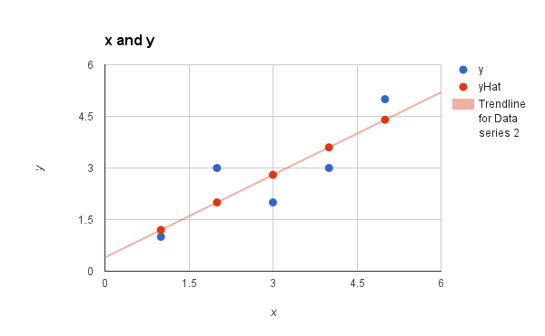
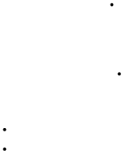
Simple Linear Regression Model

Slide 25
Estimating Error
We can calculate a error for our predictions called the Root Mean Squared Error or RMSE.
RMSE = sqrt( sum( (pi – yi)^2 )/n )
Where sqrt() is the square root function, p is the predicted value and y is the actual value, i is the index for a specific instance, n is the number of predictions, because we must calculate the error across all predicted values.

Slide 26
Estimating Error
First we must calculate the difference between each model prediction and the actual y values.
pred-y y error
1.2 1 0.2
2 3 -1
3.6 3 0.6
2.8 2 0.8
4.4 5 -0.6

Slide 27
Estimating Error
We can easily calculate the square of each of these error values (error*error or error^2).
error squared error
0.2 0.04
-1 1
0.6 0.36
0.8 0.64
-0.6 0.36

Slide 28
Estimating Error
The sum of these errors is 2.4 units, dividing by n and taking the square root gives us:
RMSE = 0.692
Or, each prediction is on average wrong by about 0.692 units.

Slide 29
QUESTIONS

